Slide 1
Graph theory in Communication and networks – Spring'16
Dynamic Communities in Evolving Network Graphs
Joseph P. Macker, David J. Claypool
Keerthiraj Nagaraj
Dept of ECE, University of Florida
Spring 2016

Slide 2
Abstract
Spectral graph partitioning is used to examine potential community structures in evolving graphs.
Evolving graps: structures vary with time.
Set of mobile network scenarios is used to explain dynamic spectral partitioning methods.
Automatic selection of number of clusters and a measure for partitioning quality.

Slide 3
Motivation
Clustering is the first step to analyze large datasets or catagorize huge networks.
Networks such as wireless mobile ad-hoc networks dynamically change their structure with time, grouping of the network nodes with some similarity measure becomes crucial to monitor these networks.
There is a need for measuring the quality of clusering to trust the results obtained from spectral clustering.
Authors have used the proposed method for analyzing the mobile network trace models to detect, stabilize and track structural community decomposition

Slide 4
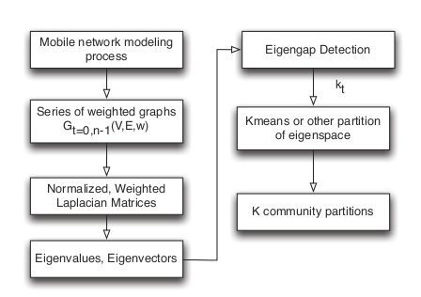
Processing models

Slide 5
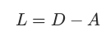
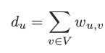
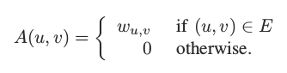
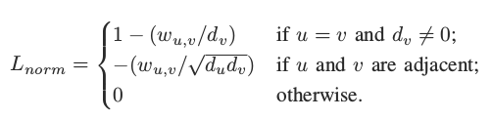
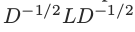
Normalized graph laplacian

Slide 6
Eigengap detection
Disadvantage of spectral clustering with K-means is that we need to input the value of number of clusters.
For this reason, spectral clustering with K-means cannot be dynamically applied to a series of graph inputs.
Eigengap detection is used to auto-configure the values of optimal number of clusters k.

Slide 7
Eigengap detection
Lgap is defined as the difference between consecutive eigenvalues of the normalized laplacian matrix.
Lgap = Ln+1 – Ln ,where Ln represents the n'th eigenvalue
All the Lgap values are calculated and max Lgap is used to decide optimal value of k.
If Lgap,max = Lk+1 – Lk then 'k' is the optimal number of clusters for input dataset

Slide 8
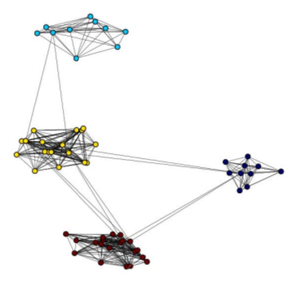
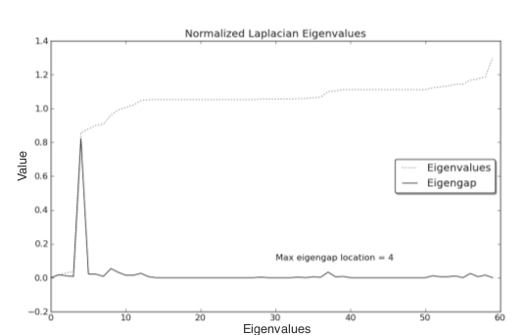
Eigengap detection

Slide 9
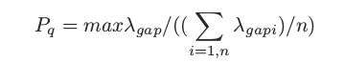
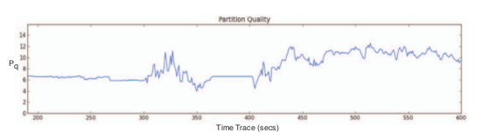
Partitioning quality measure
Partitioning information becomes less accurate as community structures become more vague such as large grid scenarios or uniform randomly generated networks.
Pq: peak-to-average ratio – Higher the value better is the quality of clustering.

Slide 10
Dynamic mobile cluster scenario
60 network nodes
Total simulation time : 600 seconds
First 200 seconds: 3 groups of 20
Next 200 seconds: 2 groups of 20 and 2 groups of 10
Last 200 seconds: 6 groups of 10

Slide 11
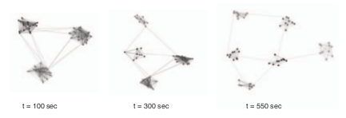
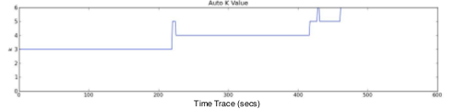
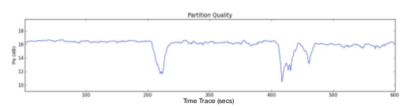
Dynamic mobile cluster scenario

Slide 12
Operationally clustered scenario
15 nodes in group A – stationery – west
15 nodes in group B – stationery – south
15 nodes – move as cluster among groups A & B, forming at times a combined unit with each of the two groups
10 high flying aerial units – backhaul network
East – grid of locally connected stationery 32 nodes with 2 of the nodes in this grid is connected to aerial backhaul network

Slide 13
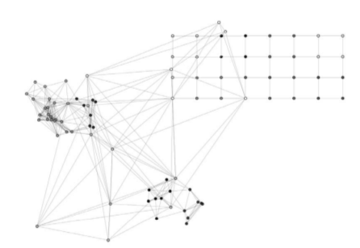
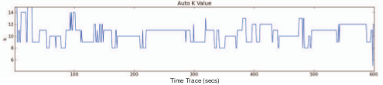
Operationally clustered scenario

Slide 14
Operationally clustered scenario

Slide 15
Future work and challenges
Formulate new metrics for measuring partitioning quality.
The proposed work could be used to improve the analysis in network planning, design and potential network cognition.
Analysis of distributed selection in mobile relay nodes based on some node centrality metric.
For large networks more computationally efficient techniques are required.

Slide 16
Conlusions
Automated spectral graph partitioning technique is implemented to detect dynamic cluster communities.
Eigengap detection is used to auto-configure the optimal number of communities.
Partitioning quality metric is defined.

